Slide 1

Department of Information Technology
NBA Accredited A.P. Shah Institute of Technology G.B.Road,Kasarvadavli, Thane(W), Mumbai-400615 UNIVERSITY OF MUMBAI Academic Year 2021-2022

Slide 2
A Project Report on Developing Smart ML Based Recommendation System Submitted in partial fulfillment of the degree of Bachelor of Engineering(Sem-8) in INFORMATION TECHNOLOGY By Sakshi Naik(17104059)
Sayali Phowakande(17104060),
Arjun Rajput(17104068) Under the Guidance of Prof. Apeksha Mohite
Prof.Geetanjali Kalme

Slide 3
1.Project Conception and Initiation

Slide 4
1.1 Abstract
Sometimes, music plays an important role in our life.
This Recommendation System is developed for those users who express their feeling and prefer listening as well as viewing music videos depending on their choice.
The recommendation system will filter out the contents depending upon user choice with similar data.
This Recommendation System, two techniques are used which are Collaborative Filtering and Content-based filtering.
Considering the issues for some users while searching they can play music with help of a voice assistant.

Slide 5
1.2 Objectives
To develop a Cross platform application.
To build a hand-free mobile application by integrating it with Voice assistant, which can make application more convenient.
To keep a track of frequently played music by user.
To provide recommendations based on recorded information of users’ preferences and suggesting video link of played music so that even videos can be watched

Slide 6
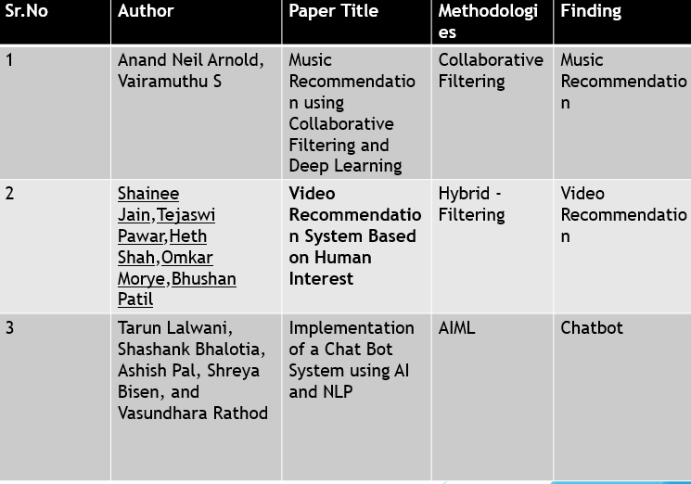
1.3 Literature Review

Slide 7
1.4 Problem Definition
Music Industry has experienced a boom in recent years due to the rapid increase in Music listeners.
The number of music available exceeds the listening capacity of a single individual.
It is sometimes difficult to choose from millions of music. However to manage this user needs a recommendation system which can help their user to introduce new music by giving quality of recommendation.
To make more innovative Voice assistants is integrated which offers a productive and personalized experience for users.
Along with the music recommendation, a video link will also be provided for those users who are willing to even watch music in video format.

Slide 8
1.5 Scope
Can be used by every music lover.
Can be useful for music creators to fetch the song of a specific genre and related.
Can be useful for user interest based recommendation.

Slide 9
1.6 Technology stack
Software Constraint
Platform used:-Windows 10
Firbase
BigQuery
TensorFlow
Hardware Requirement
Laptop or Mobile
RAM:-8GB
Front End
Kotlin

Slide 10
1.7 Benefits for environment & Society
Music is one of the solution for many problems as it helps you from reducing stress.
The reason behind most portable music systems is that music can be played whenever and wherever.
The solution for this issue is that there should be a good recommender system that can provide user music recommendations.

Slide 11
2. Project Design

Slide 12
2.1 Proposed System
The main goal of our application is to recommend users with the latest, preferred, and previously played music along with the video link. This is can be implemented by applying machine learning filtering algorithms which are collaborative and content-based filtering. This algorithm provides music based on user history and by collecting other user preferences. Following are the modules which are been considered while implementing this application.Research on the Application of Collaborative Filtering Algorithm.

Slide 13
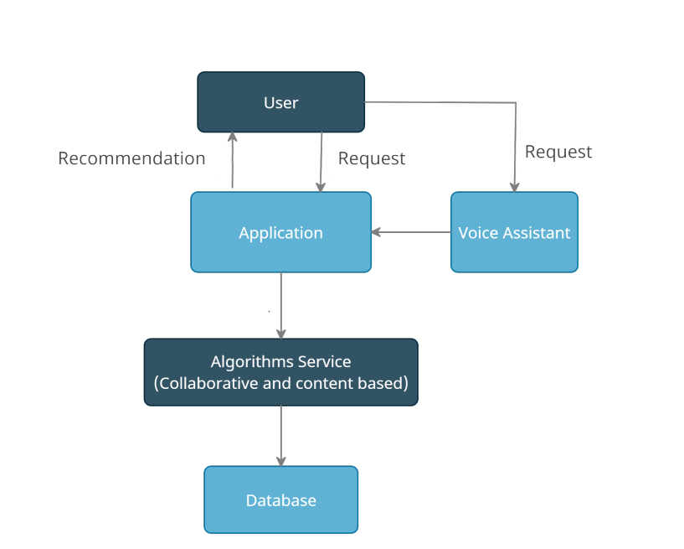

Slide 14
User
The user module is the targeted module that will request recommendations by interacting with the application or with a voice assistant to get music recommendations.
Application
This module is the main interaction with the user module which consists of a main application wherein music is recommended and played according to the user. This is a module where the user interacts the most to get recommendations.
Algorithms Service
This module consist of a Machine learning mechanism is which will recommend music by using algorithms like content-based and collaboration filtering.
Database
This module consists of a collection of user details and a music playlist which would be pushed towards user’s dashboard depending upon the algorithm.
Voice assistant
This module is implemented to perform hand-free use of application wherein user can command to assistant and assistant future send the request to the application.

Slide 15
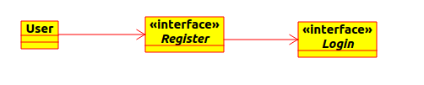


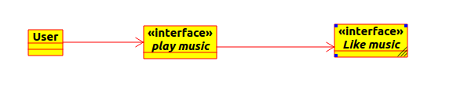
2.2 Design(Flow Of Modules)
DFD Level 0
DFD Level 1
DFD Level 2
DFD Level 3

Slide 16
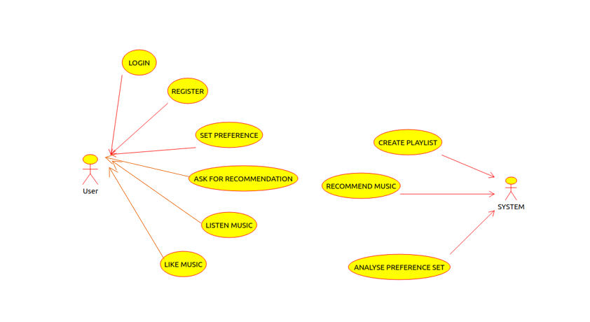
2.3 Use Case Diagram

Slide 17
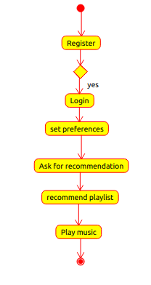
2.4 Activity diagram

Slide 18
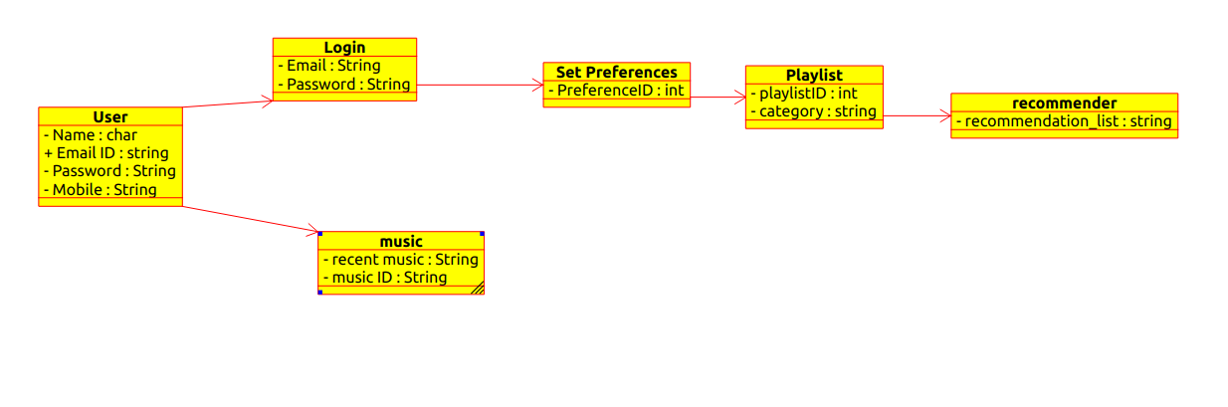
2.5 Class Diagram

Slide 19
3. Implementation

Slide 20
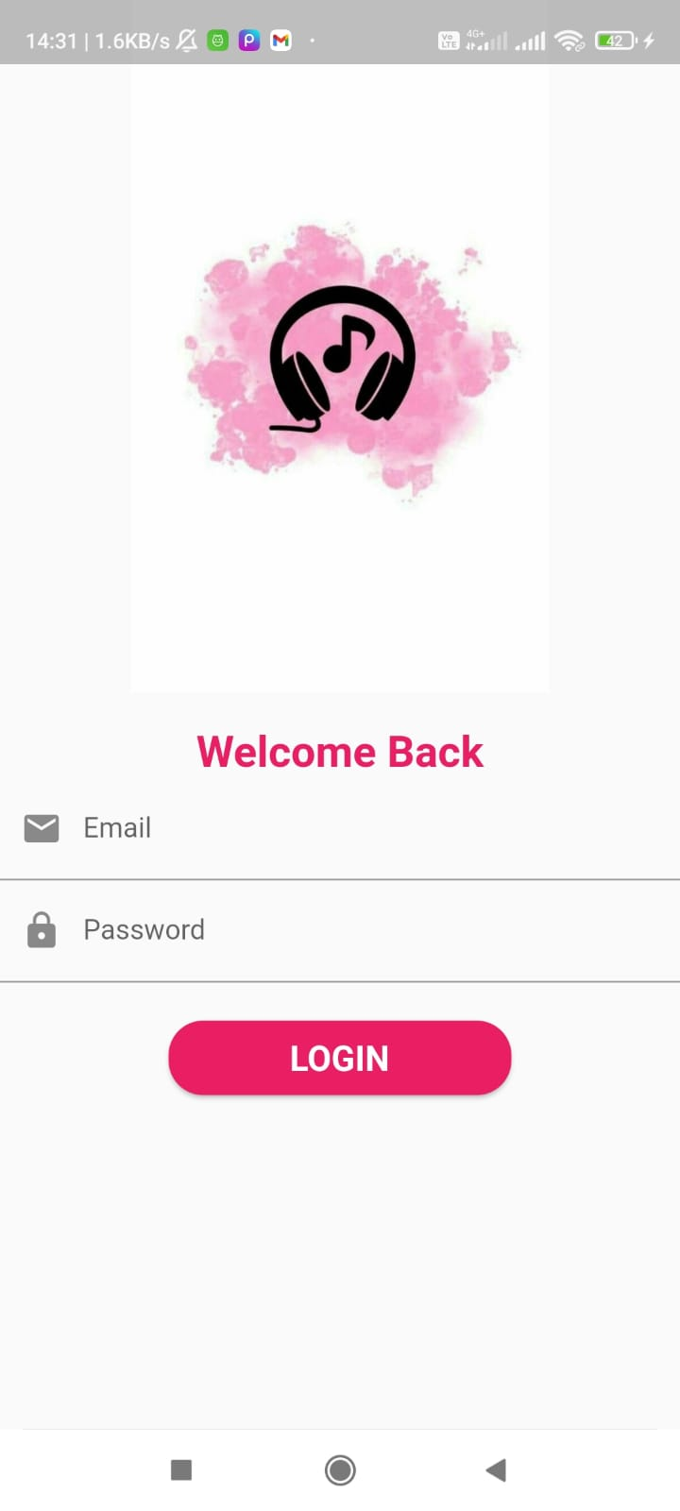
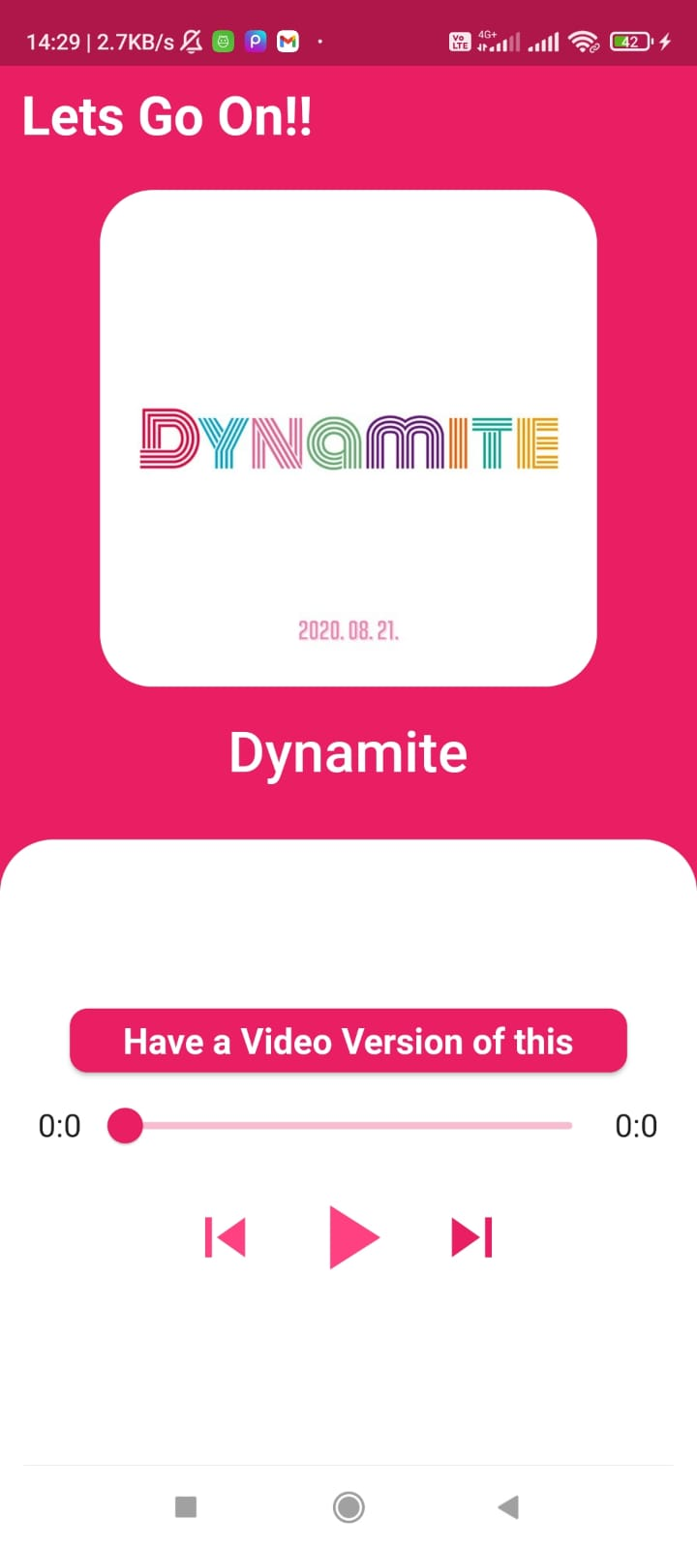

Slide 21
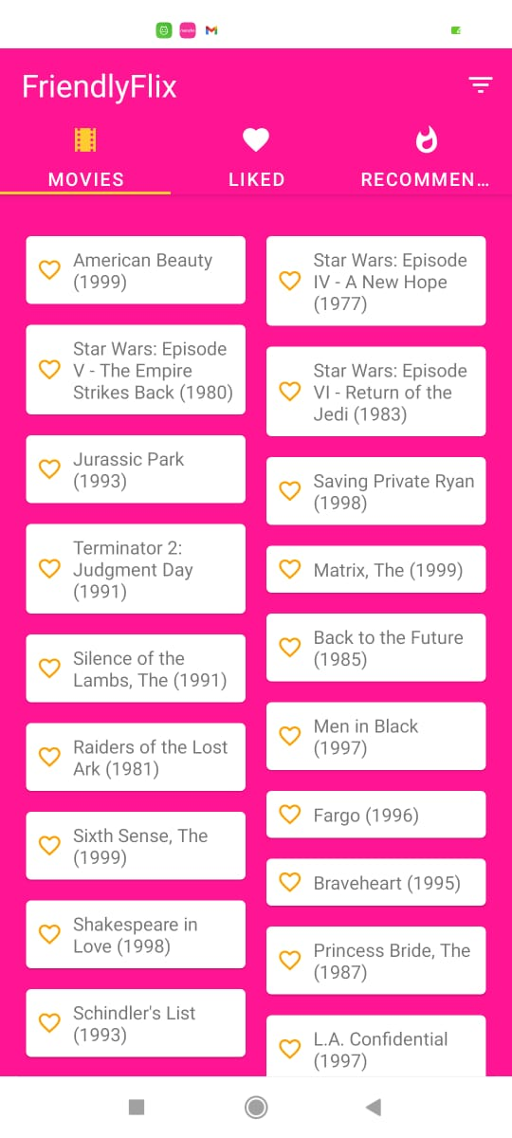
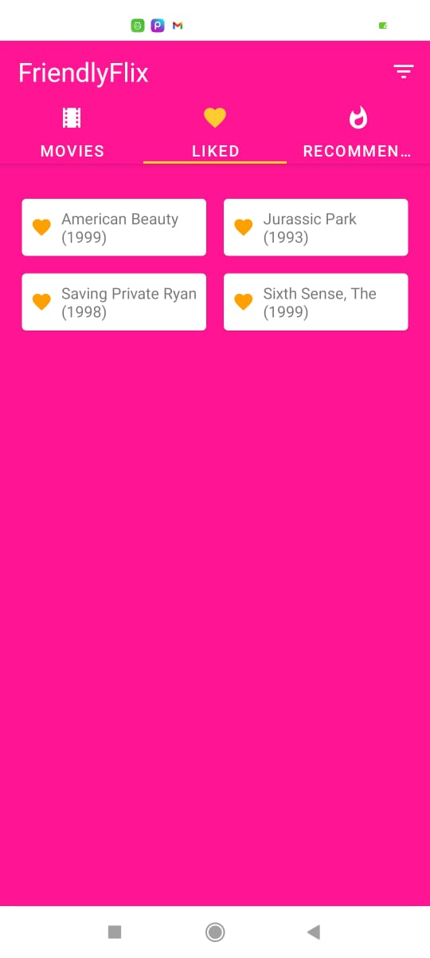

Slide 22
4. Testing

Slide 23
Unit Testing:-
Unit testing is the testing of an individual unit or group of related units. It falls under the class of white box testing. It is often done by the programmer to test that the unit he/she has implemented is producing expected output against given input. In this application actual functionality is recommend music. In this application user can see recommendation based on likes. Unit testing basically checks that whether the application is recommendation or not. User can play music as per the choice

Slide 24
5. Conclusion and Future Scope

Slide 25
By applying the knowledge and skill set, we are determined towards building a completely user interactive system that would be useful for every music listeners. This project will be implemented as a cross-platform application that will be compatible with multiple operating systems. So we have proposed a recommendation system with hybrid technique using ML. This system will recommend music to users depending upon preferences, recently played, and ratings of other users. Along with the music recommendation, a video link will also be suggested for those users who are interested to watch music in video format. To make it more innovative Voice assistants are integrated which a hand-free and personalized experience to users.

Slide 26
References
Shainee Jain; Tejaswi Pawar; Heth Shah; Omkar Morye; Bhushan Patil,” Video Recommendation System Based on Human Interest”, 2019 1st International Conference on Innovations in Information and Communication Technology (ICIICT)(IEEE).
Sheela Kathavate, “ Music Recommendation System using Content and Collaborative Filtering Methods” for IJERT : Volume 10, Issue 02 (February 2021).
Anand Neil Arnold, Vairamuthu S.,” Music Recommendation using Collaborative Filtering and Deep Learning”for International Journal of Innovative Technology and Exploring Engineering (IJITEE) ISSN: 2278-3075, Volume-8 Issue-7, May, 2019.
S Subhash; Prajwal N Srivatsa; S Siddesh; A Ullas; B Santhosh” Artificial Intelligence-based Voice Assistant”for 2020 Fourth World Conference on Smart Trends in Systems, Security and Sustainability (WorldS4).
K. D. M, D. M S, V. K. V, M. Jaincy D E, K. R A and S. Kumar R M, ”FARMER’S ASSISTANT using AI Voice Bot,” 2021 3rd International Conference on Signal Processing and Communication (ICPSC), 2021, pp. 527-531, doi: 10.1109/ICSPC51351.2021.9451760.
Xiangpo Li,”Research on the Application of Collaborative Filtering Algorithm in Mobile E-Commerce Recommendation System”for”2021 IEEE Asia-Pacific Conference on Image Processing, Electronics and Computers (IPEC)”

Slide 27
Paper Publication
Paper titled: " Developing Smart ML Based Recommendation System”, submitted to IEMIS-2022, has been Accepted for the conference.

Slide 28
Thank You

